Slide 1

Health Professional to Patient communication tool
Completing the closed communication feedback loop with patients
arcmypatient.com
arcmypatient.com

Slide 2
Application to the Clinical Governance Unit
Aim
  100% of patients to have a clear understanding of their discharge plan from ED
Background
  Many patients in ED are being discharged without a clear understanding of what the discharge instructions entail leading to readmissions and potential poor outcomes with regards to patient care and follow up
Key Benefit
  Improved Patient Safety

Slide 3
BHI report
65 - 81% (depending on self reported health status) of patients thought ED health professionals explain things in a way they could understand
86% of patients thought that during their visit to the ED, the right amount of information about their condition or treatment was given to them
76% of patients thought that an ED health professional explained the test, X-ray or scan results in a way that they could understand
60% of patients thought that an ED health professional told them about what signs or symptoms to watch out for after they went home
bhi.nsw.gov.au/Healthcare_Observer

Slide 4
Application to the Clinical Governance Unit
Describe Planned Investigations And / Or Changes
  Introduce flowchart and education program about patient discharge instructions using a similar methodology to ISBAR (attached)
  Educate the emergency health professionals in the use of the above flowchart
Describe Plans For Evaluation
  Complete survey (questions attached) of random sample of discharged patients from the ED reviewing their understanding of the discharge plan, discharge instructions and ongoing follow up.
  Compare survey responses pre and post implementation of ARC to see if there is any improvement.

Slide 5
Healthcare Professional to Patient communication tool adapted from ISBAR.
To be used at the point of discharge home or moving from ED to the ward.

Slide 6
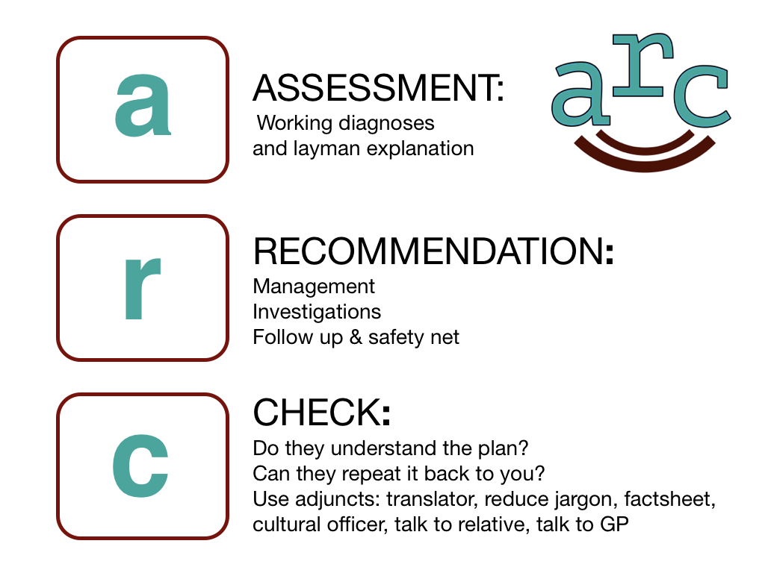

Slide 7
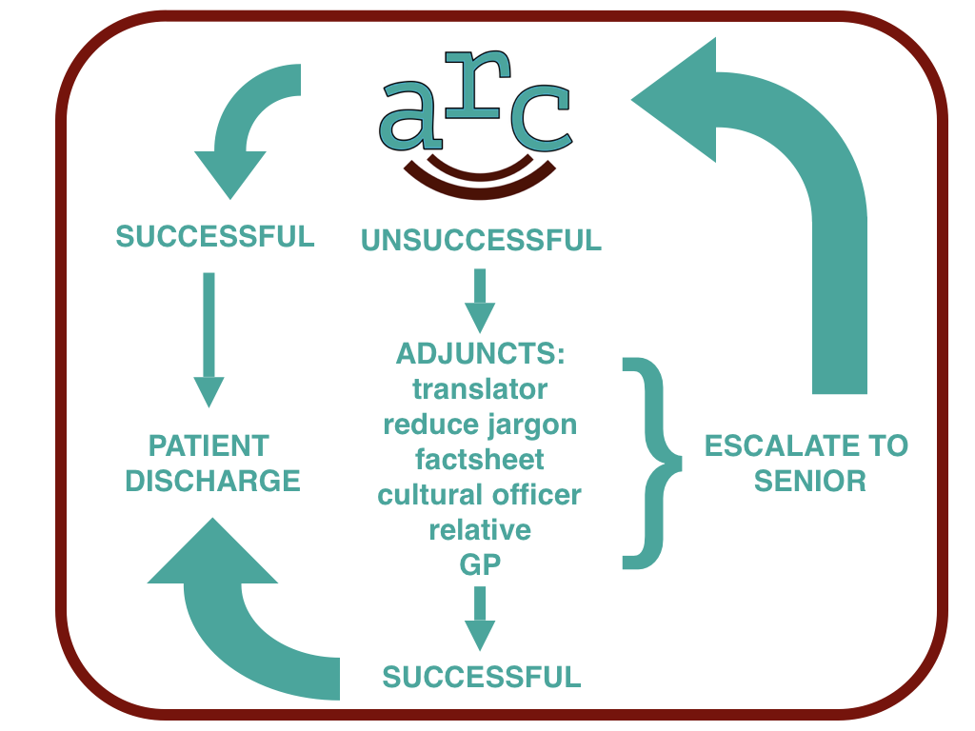

Slide 8
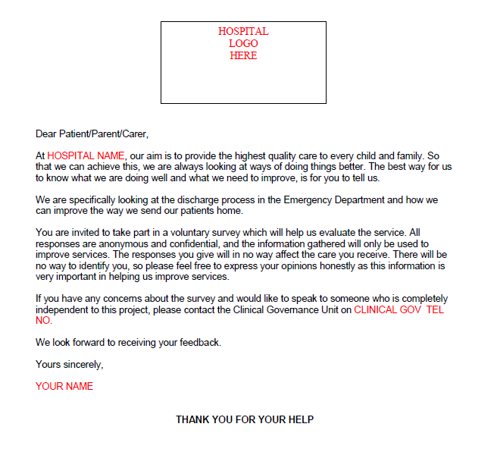

Slide 9
Patient Survey questions
Did you receive a discharge summary before being sent home?
  Yes or No
Was this summary explained to you before you were discharged?
  Yes or No
How satisfied are you with the explanation that you received about what to do with your medical care after going home?
  Scale of 1 to 5 (Very unsatisfied, unsatisfied, unsure, satisfied, very satisfied)
How confident are you about what to do if your condition worsens?
  Scale of 1 to 5 (Not very confident, not confident, unsure, confident, very confident)

Slide 10
Why introduce ARC?
Enhances patient safety
Encourages good communication
MDT tool leading to culture shift towards patient focused care
Excellent patient and medical team satisfaction results at existing sites
Cheap and easy to implement
No extra paperwork

