Slide 1
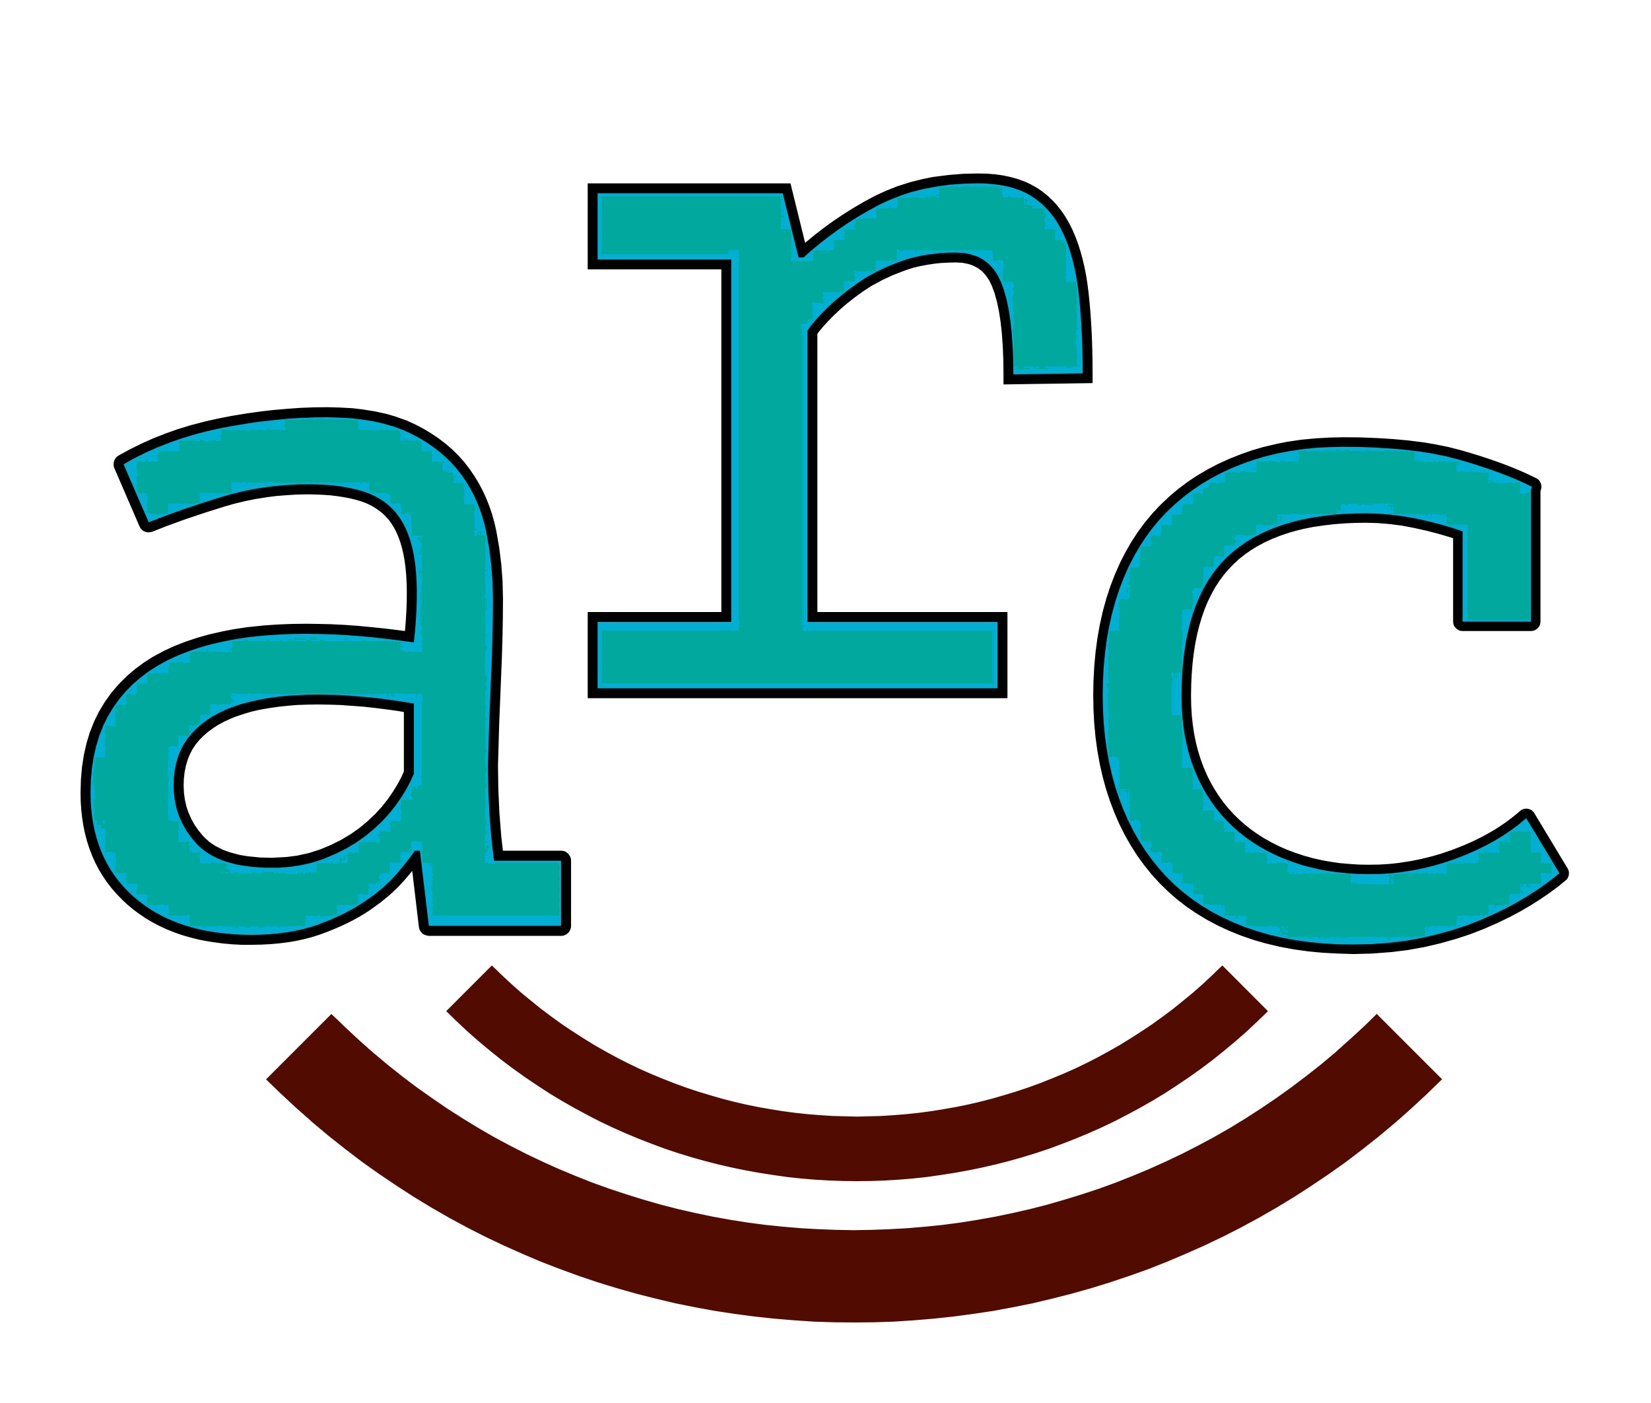
Health Professional to Patient communication tool
Completing the closed communication feedback loop with patients
arcmypatient.com
arcmypatient.com

Slide 2
The Problem
Many patients are being discharged without a clear understanding of what the discharge instructions entail leading to readmissions and potential poor outcomes with regards to patient care and follow up
Adverse events occur in approximately 1 of 5 discharges that lead to preventable hospital use
More than 33% of patients over 65yrs and 80% of all patients in public hospital settings have inadequate or marginal health literacy

Slide 3
BHI report
65 - 81% (depending on self reported health status) of patients thought ED health professionals explain things in a way they could understand
86% of patients thought that during their visit to the ED, the right amount of information about their condition or treatment was given to them
76% of patients thought that an ED health professional explained the test, X-ray or scan results in a way that they could understand
60% of patients thought that an ED health professional told them about what signs or symptoms to watch out for after they went home
bhi.nsw.gov.au/Healthcare_Observer

Slide 4
The Plan
Aim: 100% of patients will have a clear understanding of their discharge plan from ED
Intervention: Introduce flowchart and education program about patient discharge instructions using a similar methodology to ISBAR. Educate the emergency health professional team in the use of the above flowchart.
Evaluation of process: Complete survey of random sample of discharged patients from the ED reviewing their understanding of the discharge plan, discharge instructions and ongoing follow up. Compare survey responses pre and post implementation of ARC.

Slide 5
Healthcare Professional to Patient communication tool adapted from ISBAR.
To be used at the point of discharge home or moving from ED to the ward.

Slide 6
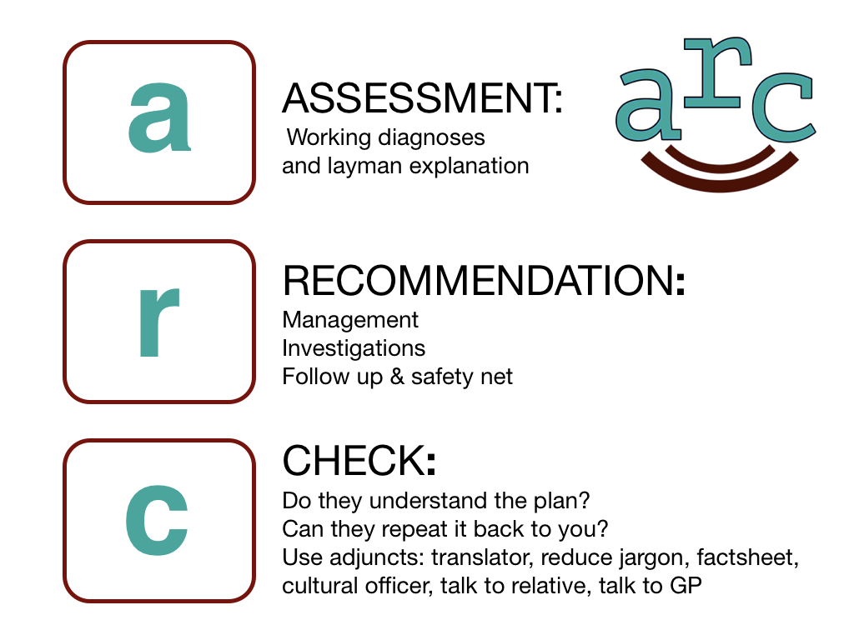

Slide 7
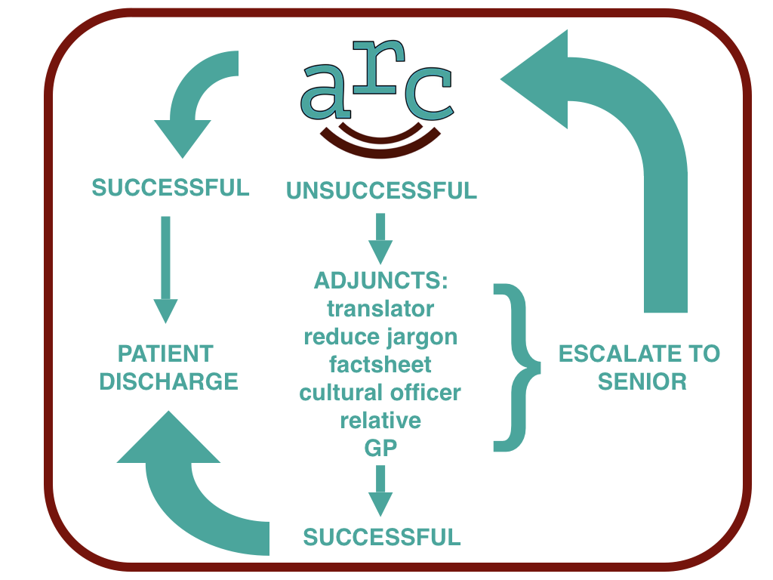

Slide 8
Why introduce ARC?
Enhances patient safety
Encourages good communication
MDT tool leading to culture shift towards patient focused care
Excellent patient and medical team satisfaction results at existing sites
Cheap and easy to implement
No extra paperwork

